Slide 1
Breeding and Caring for Healthy Horses
The “Path-Away®” Success Program
Notes:
This template is provided by http://www.free-power-point-templates.com/

Slide 2
Horse Events Span Many Venues
Show jumping and dressage
Harness racing
Steeplechase
Polo
Thoroughbred horse racing

Slide 3
Event Commonality
Whether your horse is for pleasure, hobby or a business venture one thing is absolutely certain.
Your horse must be in
peak physical condition
to perform at its best!
They are easily affected by weather, feeding and proper shelter and grooming as well as unexpected diseases.

Slide 4
Common Equine Issues
Sprains and Strains
Allergies
Colic
Dehydration issues
Parasites
Dermatitis and Skin rashes
Stomach problems
Fungal / Bacterial infections
Equine encephalitis
Worms and Insects

Slide 5
Skin Problems
Many of these disorders share the same appearance
Hair Loss
Itchiness
Lesions
Open sores
Crusty skin surfaces
Scaly skin surfaces
Flaky Skin surfaces
Thickened skin surfaces

Slide 6
Fungal Infections
Funguses (also called fungi) are parasitic, spore-producing organisms. They obtain their nourishment by absorbing food from the hosts on which they grow.
Aspergillosis
Candidiasis
Coccidioidomycosis
Cryptococcosis
Phythiosis
Rhinosporidiosis

Slide 7
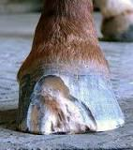
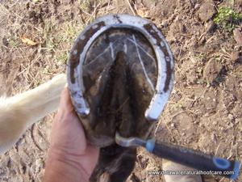
Hoof Fungus
The two most common fungal maladies affecting horses’ hooves occur in the hoof wall and the frog.
Fungal infections from direct pathogen contact

Slide 8
Mycotoxins
Pasture grasses, hay, grain, straw and stubble can all support the growth of various fungal mycotoxins.
Fungi and their associated mycotoxins are present on grain crops in varying amounts each year, depending on the climatic growing conditions. A cool, wet, growing season increases the likelihood that fungi, especially Fusarium and its mycotoxins, will be present in small grains.

Slide 9
Mycotoxin Levels for Horses
Tolerance Levels of Mycotoxins in Total Ration (ppm)
Toxin | Horse | Limits
Aflatoxin | 0.2 ppm | Maximum for immature horses
T-2 Toxin | 0.7 – 1.5 ppm | No effect up to 1 ppm
Deoxynivalenol | 2.5 – 6 ppm | 5 ppm allowed in grain
Zearalenone | 3.9 – 7.0 ppm | No effect on mares < 1ppm
Fumonisins | 30 ppm max | OK if diet is < 20% grain
Ergovaline | .4 - .7 ppm | No effect on healthy horse

Slide 10
Molds
Pasture grasses, hay, grain, straw and stubble can all support the growth of various fungi.
Alternaria Fusarium
Aspergillus Mucor
Cladosporum Penicillium
Rhizopus
Moldy Hay Invasive Molds

Slide 11
Effects of Moldy Feed Stock
Horses are particularly sensitive to dust from mold spores and can get a respiratory disease similar to asthma in humans called Recurrent Airway Obstruction (RAO), commonly referred to as heaves.
A horse with RAO will have a normal temperature and a good appetite, but will often have decreased exercise tolerance. Labored breathing occurs during exercise and often while at rest.

Slide 12
Anti Mold Pathogen Care
Do not feed dusty and moldy hay and grains.
Use dust-free bedding such as shredded paper or rubber mats.
Place feed at a lower level so particles are not inhaled through the nostrils.
Keep your horse out of the stable when you are cleaning and sweeping to reduce exposure to dust.

Slide 13
Anti Mold Pathogen Care
Feed hay outside to minimize dust problems.
Soak dusty hay for 5 to 30 minutes before feeding.
Store hay away from your horse and ensure any hay in the vicinity is kept dry to reduce mold.
If the horse is housed indoors, ensure that there is good, draft-free ventilation.

Slide 14
Intestinal Issues
Intestinal Clostridiosis is a disease which causes diarrhea in horses.
Symptoms A horse with intestinal clostridiosis will be reluctant to drink. It may stand by the water, not drink, and yet be visibly thirsty. Its mucous membranes -- especially near the anus -- become congested and dark red in color.

Slide 15
Intestinal Issues
Additional symptoms:
Depression.
Weakness.
Inclination to lay down or recline.
Severe diarrhea (i.e., projectile diarrhea, foul-smelling feces, liquid feces).

Slide 16
Influenza
Influenza is a highly contagious infection of the upper respiratory tract of horses
Equine influenza, commonly referred to as “the flu,” is a highly contagious, rapidly spreading, upper respiratory tract infection caused by strains of the influenza virus type A and others.
Horses become infected by inhaling the influenza A virus shed by infected, coughing horses. The virus can also be spread via contaminated equipment such as feed buckets, tack, and grooming aids.

Slide 17
Influenza Symptoms
The virus has a very short incubation period of only one to three days, and signs of influenza are obvious two to three days after initial virus exposure. Also look for:
Sudden onset of a high fever (up to 106°F);
A dry, deep cough that helps spread the virus.
A serous (clear, runny) nasal discharge.
Sometimes mild swelling of the submandibular (under the jaw)
or lymph nodes and trunk in affected horses.
Possible edema (swelling) of the distal limbs and trunk.

Slide 18
Insects, Bugs and Parasites
Arthropods that feed on blood generally affect horses directly/indirectly.
Blister Beetles
Face and House Fly
Stable Fly
Horn Fly
Horse Fly
Deer Fly
Mites
Black Fly
Gnat
Biting Midges
Mosquito
Bot Fly
Lice
Ticks

Slide 19
Respiratory Complications
Debilitation
Spread of disease to other horses
Loss of animal

Slide 20
The Path-Away® Solution
Path-Away Anti-Pathogenic Aerosol Solution® provides
broad spectrum protection against harmful pathogens as
well as vector (insect) borne diseases.
Path-Away Anti-Pathogenic Aerosol Solution® is effective
against the major diseases affecting the equine industry
and its pheromone disruption technology keeps disease
carrying insects to a minimum.

Slide 21
The Path-Away® Solution
Product application
Manual application: Manual application is achieved through use of a portable fogging machine such as the Stihl 450.
The M3 System: Any size and configuration of stable can be outfitted with our M3 System Distribution Unit. This will provide fully automatic, adjustable product application.

Slide 22
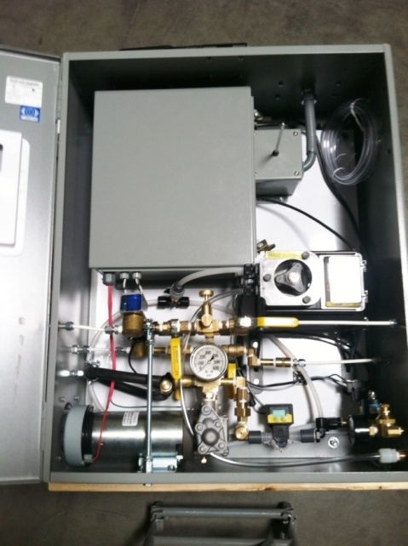
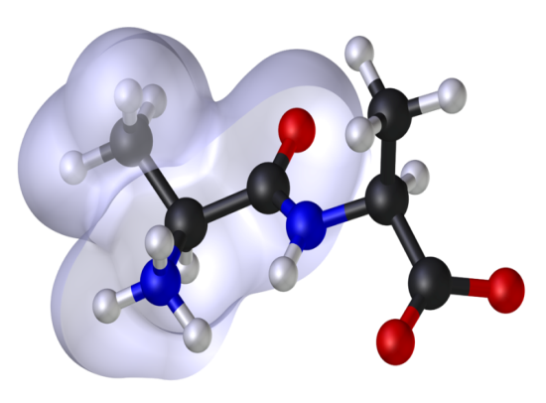
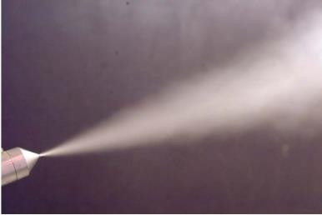
The Path-Away® Solution
Stihl 450
The M3 System Distribution Module

Slide 23
Thoroughbred Horse Stable Project
This stable held ten (10) horses, feed, tack and working quarters for the full time staff.
A total pathogen assessment was requested due to a recent illness in one of the horses.
A total pathogen matrix identification and quantification is highly recommended to establish a baseline from which to make permanent, long term recommendations to control the situation.

Slide 24
Preliminary Assessment
Pre Path-Away® Screening
Coliform bacteria identified as being present
E coli bacteria identified as being present
Streptoccocus identified as being present
Staphylococcus identified as being present
Enterococcus identified as being present
Gram positive bacteria levels ……………………… 30,000,000 CFU
Gram negative bacteria levels ……………………. 30,000,000 CFU

Slide 25
Post Path-Away® Levels
Path-Away Anti-Pathogenic Aerosol Solution® was manually applied by means of a portable, hand held electric powered fogging machine. Samples for laboratory analysis were collected after the process had been completed.
Offensive odors were noticeably absent after treatment.

Slide 26
Post Treatment Assessment
Post Path-Away® Screening
Coliform bacteria identified as being absent.
E coli bacteria identified as being absent.
Streptoccocus identified as being absent.
Staphylococcus identified as being absent.
Enterococcus identified as being absent.
Gram positive bacteria levels ……………………… 10 CFU
Gram negative bacteria levels ……………………. 10 CFU

Slide 27
Path-Away® Success
Total Pathogen Reduction
99.9999%

Slide 28
Path-Away® Testimonial

Slide 29
www.giccllc.com

