Slide 1
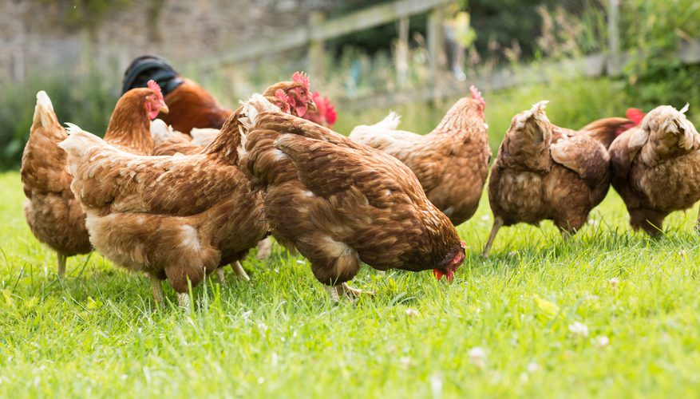
Sustainable poultry breeding using the Path-Away® method

Slide 2
Main Goals
Increase total revenue, and net margin from operations
Achieve larger bird size
Healthier birds
Improve feed conversion rates
Increase egg production, while lowering egg loses
Breed chemical-free and organic birds and eggs
Reduce insect and parasite burden
Reduce ammonia smell
Apply to full operation from breeding to bird processing

Slide 3
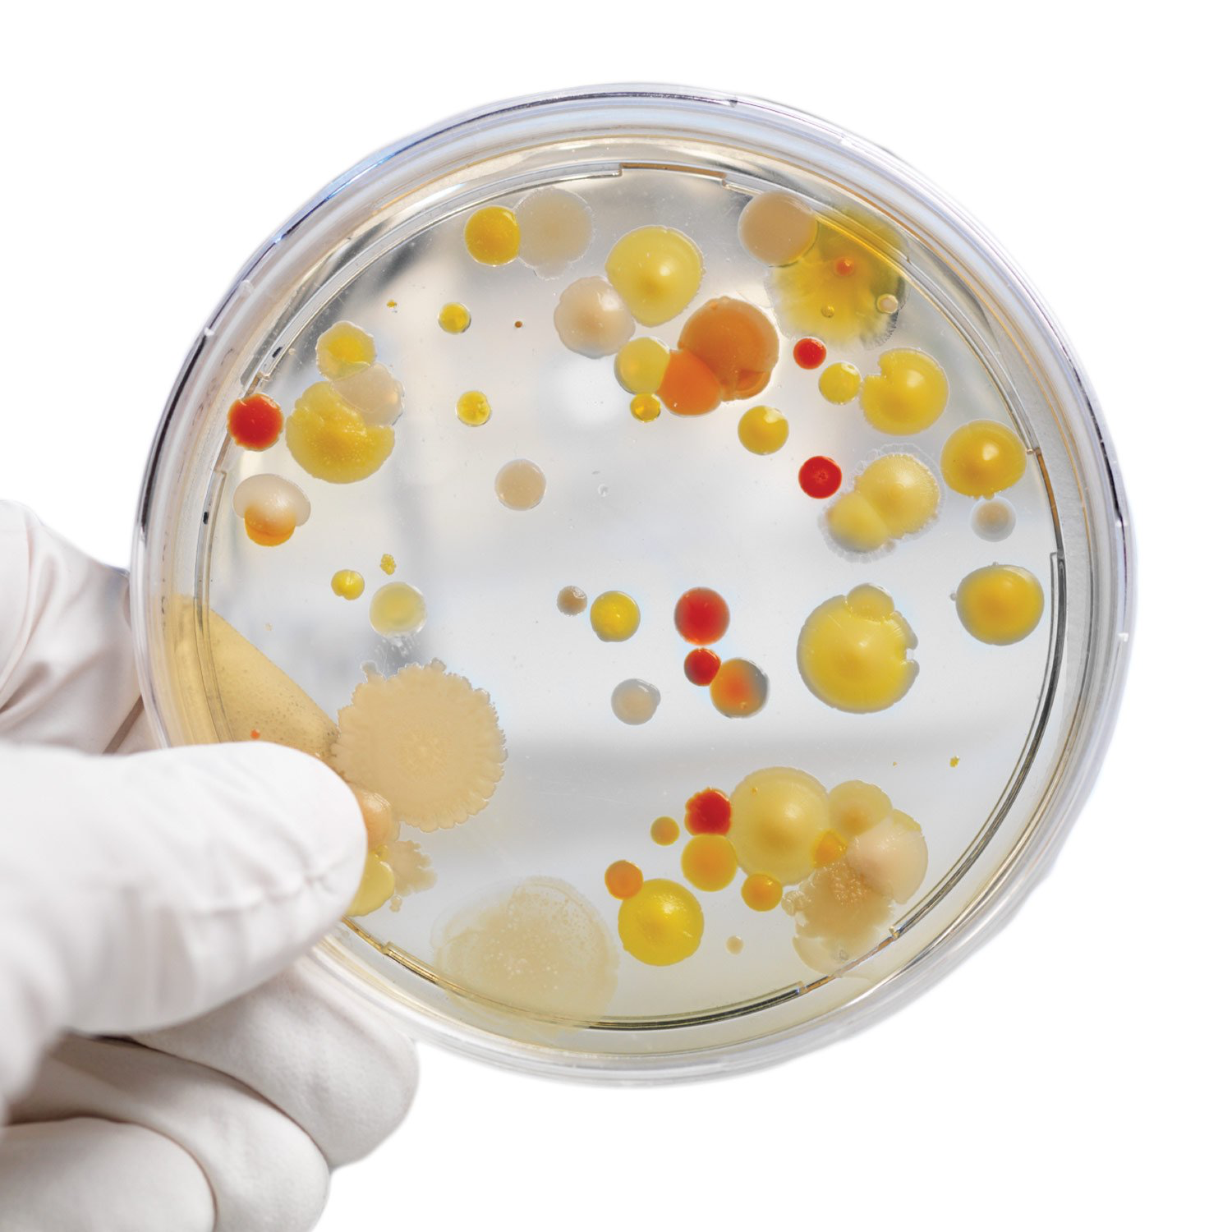
Main Pathogen Transmitting Vectors
Introduction of infected chicks/eggs
Waste
Surfaces and breeding house structure
Transport vehicles
Contaminated bird feed
Insects, wildlife, and disease carrying humans
Water sources

Slide 4
Current Methodology
Regular application of chemical disinfectants
Antibiotic application in response to localized outbreaks
Frequent loss of feed due to contamination
High ventliation rates to lower ammonia content
Expensive and labor intensive insect control

Slide 5
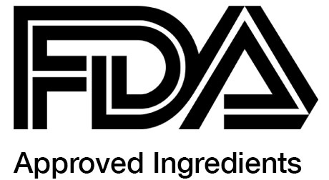
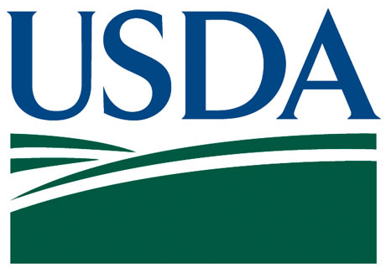
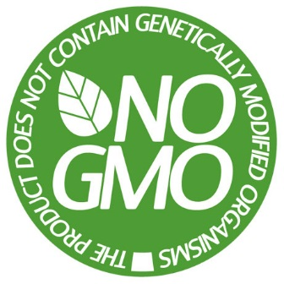
Path-Away ® Methodology
Our Path-Away ® methodology consists of procedures that have been tested, proved and approved
Provable results that have been documented in multiple scenarios

Slide 6
Path-Away® Poultry Protectant
100% plant-based
Certified Organic
Non-GMO
Alcohol Free
Non-toxic to bees
Proven against 170+ pathogens
100% soluble
No chemicals added
FDA approved ingredients
USDA approved
Can be applied while birds are present

Slide 7
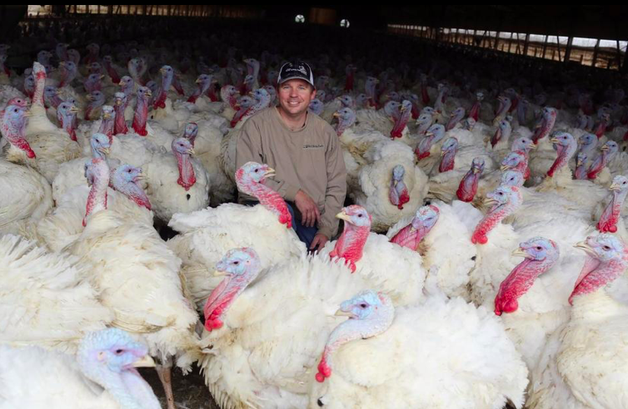
Use case 1: Turkeys
Wayland, USA

Slide 8
Wayland Turkey Farm
Prior to Path-Away® Methodology
10 sheds in operation
8,000 birds per shed
Average culled bird weight 42lbs.
Mortality rate at 19 weeks: 7-15 birds/week
Low conversion rate
High incidence of darkling beetles
High chemical and antibiotic costs incurred

Slide 9
Using Path-Away®

Slide 10
Wayland Turkey Farm
Results of applying the Path-Away® Methodology
10 sheds in operation
8,000 birds per shed
Average culled bird weight: 45lbs. (+3 lbs.)
Mortality rate at 19 weeks: 1-2 birds per week (-85%)
Mortality rate increased one full percentage point
Darkling beetles can no longer be found upon inspection
50% reduction in chemical and antibiotic costs

Slide 11
Wayland Turkey Farm
Results of applying the Path-Away® Methodology
Near elimination of ammonia odor resulting in:
Elimination of “leg weakness”, a primary cause of death in birds
Higher water consumption of birds (Higher weight, healthier birds)
Higher feed conversion resulting in more efficient weight gain
Reduced external complaints from neighboring locations

Slide 12
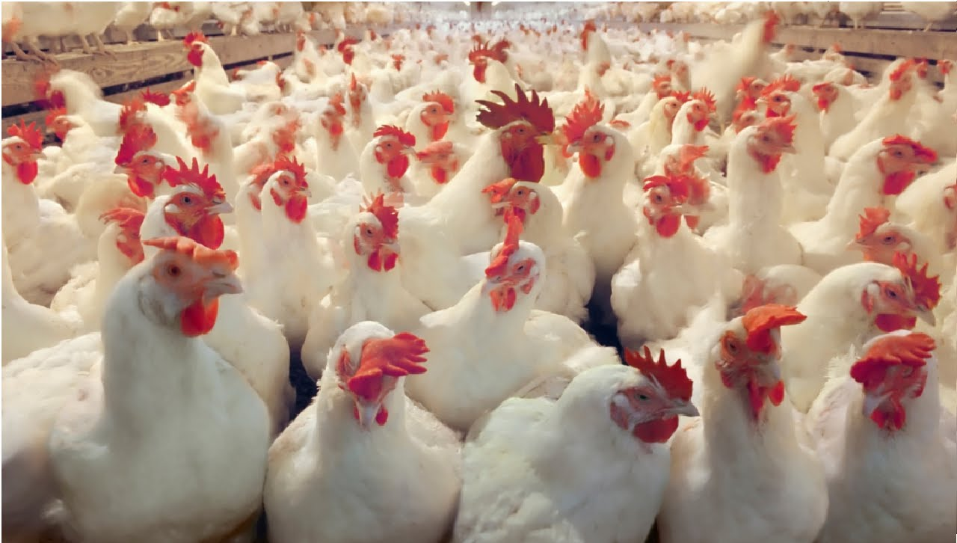
Use Case 2: Poultry
Mississippi, USA

Slide 13
Mississippi Poultry Farm
Birds produced per year 90,000,000
Loss of chicks (≤5 days) 12%
Bacteria species identified 65
Very high levels of ammonia detected
Darkling beetle infestation in both sheds and feed
EPA complaints
Neighbor complaints
Humane society complaints

Slide 14
Proyecto: Avícola Mississippi USA
Pre Path-Away® Method
Ammonia Count 67ppm
Ammonia Produced 100+lbs.
Bacteria identified 65
Bird Loss 12%
Feed Loss 500lb./cycle
Note: Birds go blind when exposed to ammonia at 50ppm+
Post Path-Away® Method
Ammonia Count 3-8ppm
Ammonia Produced <5 lbs.
Bacteria identified 2
Bird Loss 6%
Feed Loss < 50lb./cycle

Slide 15
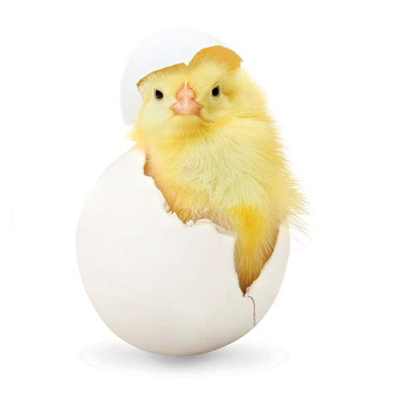
Use of Path-Away® in Breeders

Slide 16
Use of Path-Away® in Breeders
Microbial contamination of hatching eggs is a main concern of poultry producers as it causes poor hatchability and chick performance.
High standards of hygiene must be maintained in hatcheries in order to minimize the soiling of eggs. Further disinfection of eggs is also necessary to limit bacterial numbers

Slide 17
Use of Path-Away® in Breeders
Methods used include the application of disinfectants by wiping, spraying, and dipping but, arguably, the most effective way of disinfection of hatching eggs is fumigation with formaldehyde. Eggs can be fumigated during incubation or just after the transfer to the hatchery, but most commonly it is prior to incubation. Formaldehyde is also a toxic chemical and, as such, can seriously damage the dormant embryo.

Slide 18
Formaldehyde vs. Path-Away®
Formaldehyde | Path-Away®
Chemical based | Organic based
Eye contact hazard | Slight stinging
Skin contact hazard | None
Inhalation hazard | None
Ingestion hazard | None FDA approved ingredients
Flammable | Non-flammable
Safety glasses, respirator, gloves | Safety glasses only
Toxicity LD50 42 mg/kg | Toxicity LD50 180,000 mg/kg
Formaldehyde is 4,285 times more toxic than Path-Away®

Slide 19
Formaldehyde vs. Path-Away®
Formaldehyde | Path-Away®
Concentration/time sensitive. Suggested 20 minute time. Possible cuticle degradation. | Verified concentration/time it is effective in less than 5 minutes. Harmless to egg structure
Humidity of pathogenic genus | Humidity tolerant
Temperature sensitive Storage temperature critical | Thermo tolerant Not affected by storage temps
Organic matter content on shell affects efficacy by extending contact time | Efficacy on 170+ pathogens and not affected by organic surface material

Slide 20
Formaldehyde vs. Path-Away®
Formaldehyde | Path-Away®
Effected by egg shell quality | Not affected
Effected by age of breeder stock | Not affected
Effected by actual egg size | Not affected
Effected by yolk-shell distance | Not affected
Effected by egg cuticle thickness | Not affected

Slide 21
Other Hatchery Considerations
Formaldehyde: Eggs should not be fumigated between 24 and 84 hours of incubation. Developing embryos are particularly sensitive to formaldehyde gas between 24 and 96 hours of incubation, and embryonic mortality increased if exposed during this period.
Path-Away® Due to the organic molecular composition of Path-Away® coupled with its extremely low toxicity but high efficacy, embryonic mortality is minimized during prolonged or multiple applications

Slide 22
Other Hatchery Considerations
Newly hatched chicks can easily get infected by microbes even if the eggs were clean. Fumigation of eggs immediately after transfer to the hatchery can minimize the number of pathogenic microorganisms and thus increase the number of healthy chicks. Fumigation at this stage of the incubation requires great care because the embryo becomes a direct-air-breathing animal.
The organic, extremely low toxicity of Path-Away® makes this a safer procedure.

Slide 23
Conclusions
Path-Away® is a safer product
Path-Away® is a more user friendly product
Path-Away® is a more effective product
Path-Away® will reduce your product losses
Path-Away® will extend your market share
Path-Away® will make poultry production more profitable

Slide 24
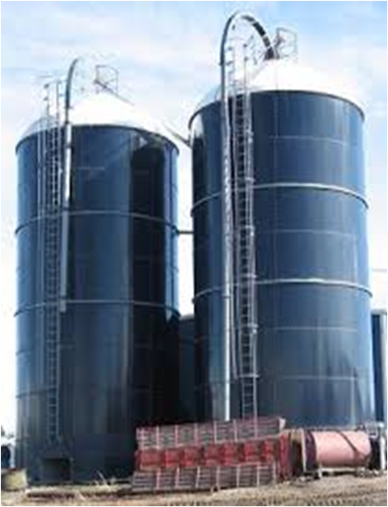
Feed Storage Protection
Some of the biggest issues with long term feed storage are fungi such as
Aspergillus niger, Alternaria, Drechlera, Nigrospora, Periconia and Penicillium.
At 500 CFU/Bushel grain is not usable.
Pre Path-Away® treated silo @ 15 days:
17.5% moisture.
150-350 CFU multiple fungi
Post Path-Away® treated silo @15 days: 17.5% moisture
50-120 CFU two (2) fungi

