Slide 1
Enhanced Shipping Protection With Path-Away®
Providing Secure, Safe, Sanitary Shipping Services

Slide 2
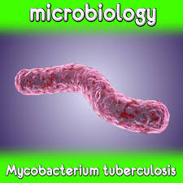
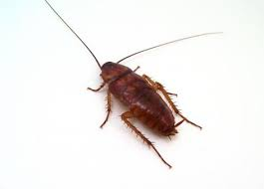
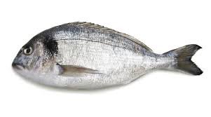
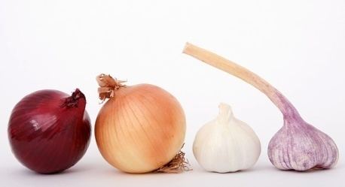
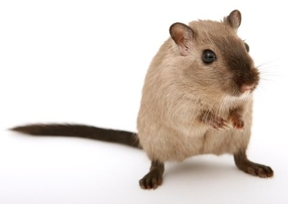
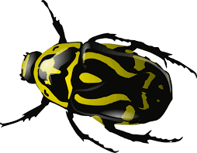
What was in that container & Where did it originate?
Potential odor issues contaminating your product
Potential insect infestation on your product
Potential transmission of disease causing agents

Slide 3
Container Being Loaded in Bangladesh
Barefoot workers loading a container with a wooden floor.
Health hazard to workers on site.
Potential transmission of disease to receiver.

Slide 4
Penetrating Odors
Odor is a chemical reaction
Odor is affected by temperature
Odor is affected by humidity
Odor can become more pungent if mixed with another odor.
Odor can be transmitted one substance to another (dirty container your goods).

Slide 5
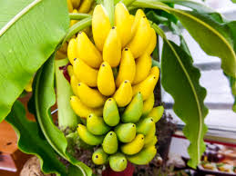
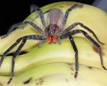
Insect Infestation
Raw food products harbor numerous species of insects, Some can be highly dangerous and toxic depending on species and origination.
Banana Tree
Banana Spider
venomous

Slide 6
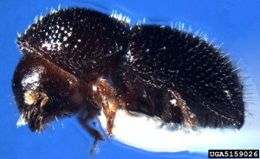
Insect Infestation
Raw food products harbor numerous species of insects. Some can be highly dangerous and toxic depending on species and origination.
Coffee Beans
Black Twig Borer

Slide 7
Insect Infestation
Foodstuffs are not always decontaminated properly
There is potential product damage
There is potential spread of invasive species
There are potential health problems to your workers unloading cargo
Potential spread on invasive species

Slide 8
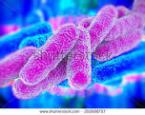
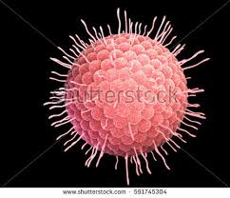
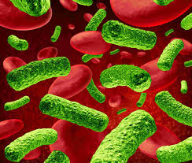
Disease Transmission
Fungi, Bacteria, Yeasts and Viruses
Can live for weeks in shipping containers
Severe danger to workers
Can be transmitted to your clients

Slide 9
Current Sanitization Procedure
Water wash-down of interior (water is a prime factor in pathogen growth)
Steam cleaning (still leaves moisture which fosters pathogen growth)
Antiquated - Outdated - Ineffective

Slide 10
Old Methods Can Leave You Facing
P.D.

Slide 11
What Is P.D.
Punitive Damages
Don’t leave your company or yourself open to legal damages that could put you out of business

Slide 12
The Path-Away® Solution Is Here
One product sanitizes and deodorizes
Totally organic
Biodegradable
Non-toxic
Effective on 170+ pathogens including fungi, bacteria, yeasts and viruses.
Global organic certification and approval
Scientifically developed in the USA
Highly effective against insects and vermin

Slide 13
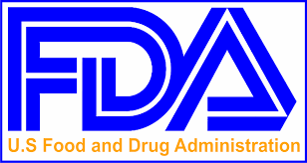
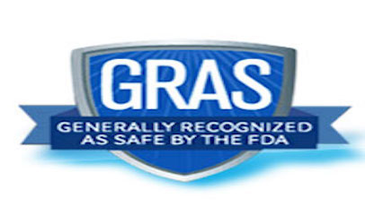
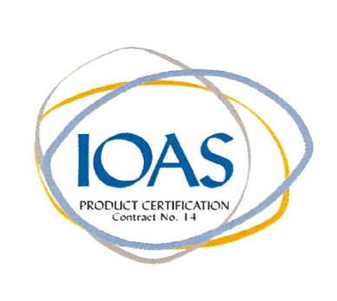
Tested Proven Approved

Slide 14
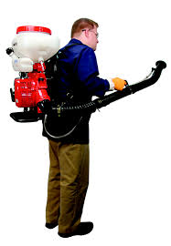
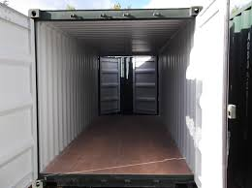
Simple And Quick Application Procedure
Let our specially trained technicians clean,
sanitize and deodorize your container and
provide a safe transportation module

Slide 15
Benefits of the Path-Away® Method
Tested
Proven
Approved
Effective
Biodegradable
Easily applied
Organic
Environmentally safe
Done on site
Inexpensive

Slide 16
Benefits of the Path-Away® Method
Protect your product shipments
Protect your workers
Protect other on site personnel
Protect your business
Provide liability protection

Slide 17
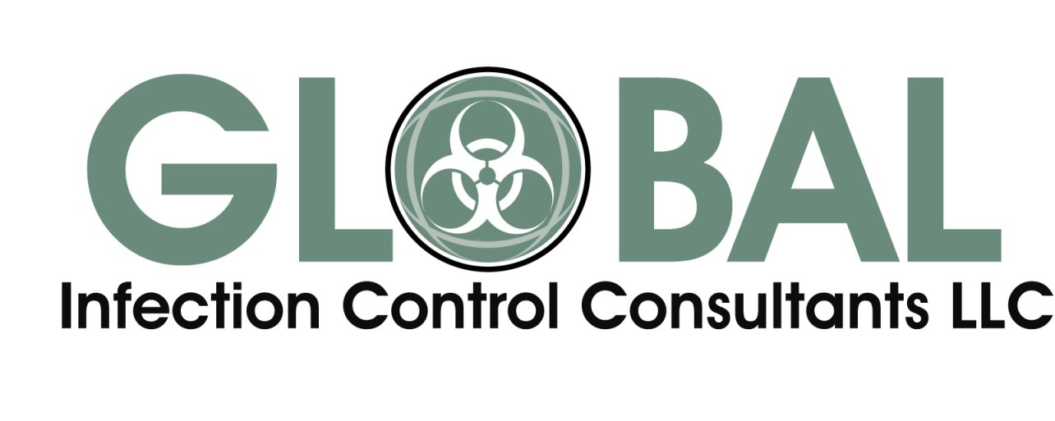
Contact Us Today For Information
www.giccllc.com

